Slide 1
COMPUTER GRAPHICS & IMAGE PROCESSING (21CS63) MODULE 3
VARALAKSHMI B D
ASSISTANT PROFESSOR
Department of Computer Science & Engineering
VI Semester
2023-24

Slide 2
Module 3:8 Designing a Graphical User Interface
A common feature of modern applications software is a graphical user interface (GUI)composed of display windows, icons, menus, and other features to aid a user in applying the software to a particular problem.
Specialized interactive dialogues are designed so that programming options are selected using familiar terms within a particular field, such as architectural and engineering design, drafting, business graphics, geology, economics, chemistry, or physics.

Slide 3
The User Dialogue
For any application, the user’s model serves as the basis for the design of the dialogue by describing what the system is designed to accomplish and what operations are available. It states the type of objects that can be displayed and how the objects can be manipulated.
For example, if the system is to be used as a tool for architectural design, the model describes how the package can be used to construct and display views of buildings by positioning walls, doors, windows, and other building components.
A facility-layout package might include a set of furniture items along with the operations for positioning and removing different objects in a specified floor plan. A circuit-design program provides electrical or logic symbols and the positioning operations for adding or deleting elements within a layout.

Slide 4
Windows and Icons
Typical GUIs provide visual representations both for the objects that are to be manipulated in an application and for the actions to be performed on the application objects.
In addition to the standard display-window operations, such as opening, closing, positioning, and resizing, other operations are needed for working with the sliders, buttons, icons, and menus.
Some systems are capable of supporting multiple window managers so that different window styles can be accommodated, each with its own window manager, which could be structured for a particular application.

Slide 5
Accommodating Multiple Skill Levels
Usually, interactive GUIs provide several methods for selecting actions. For example, an option could be specified by pointing to an icon, accessing a pull down or pop-up menu, or by typing a keyboard command. This allows a package to accommodate users that have different skill levels.
A less experienced user may find an interface with a large, comprehensive set of operations to be difficult to use, so a smaller interface with fewer but more easily understood operations and detailed prompting may be preferable.
A simplified set of menus and options is easy to learn and remember, for the user can concentrate on the application instead of on the details of the interface.

Slide 6
Accommodating Multiple Skill Levels-contd
Simple point-and-click operations are often easiest for an inexperienced user of an applications package. Therefore, interfaces typically provide a means for masking the complexity of a package, so that beginners can use the system without being overwhelmed with too much detail.
Experienced users, on the other hand, typically want speed. This means fewer prompts and more input from the keyboard or with multiple mouse-button clicks.
Actions are selected with function keys or with simultaneous combinations of keyboard keys, because experienced users will remember these shortcuts for commonly used actions.
An interface may be designed to provide different sets of options to users with different experience levels

Slide 7
Consistency
An important design consideration in an interface is consistency. An icon shape should always have a single meaning, rather than serving to represent different actions or objects depending on the context.
Some other examples of consistency are always placing menus in the same relative positions so that a user does not have to hunt for a particular option, always using the same combination of keyboard keys for an action, and always using the same color encoding so that a color does not have different meanings in different situations.

Slide 8
Minimizing Memorization
Operations in an interface should also be structured so that they are easy to understand and to remember. Obscure, complicated, inconsistent, and abbreviated command formats lead to confusion and reduction in the effective application of the software.
One key or button used for all delete operations, for example, is easier to remember than a number of different keys for different kinds of delete procedures.

Slide 9
Backup and Error Handling
A mechanism for undoing a sequence of operations is another common feature of an interface, which allows a user to explore the capabilities of a system, knowing that the effects of a mistake can be corrected.
Typically, systems can now undo several operations, thus allowing a user to reset the system to some specified action. For those actions that cannot be reversed, such as closing an application without saving changes, the system asks for a verification of the requested operation.
In addition, good diagnostics and error messages help a user to determine the cause of an error.

Slide 10
Feedback
Responding to user actions is another important feature of an interface, particularly for an inexperienced user. As each action is entered, some response should be given. Otherwise, a user might begin to wonder what the system is doing and whether the input should be reentered.
Feedback can be given in many forms, such as highlighting an object, displaying an icon or message, and displaying a selected menu option in a different color. When the processing of a requested action is lengthy, the display of a flashing message, clock, hourglass, or other progress indicator is important.
It may also be possible for the system to display partial results as they are completed, so that the final display is built up a piece at a time. The system might also allow a user to input other commands or data while one instruction is being processed.

Slide 11
Design of Animation Sequences
Constructing an animation sequence can be a complicated task, particularly when it involves a story line and multiple objects, each of which can move in a different way. A basic approach is to design such animation sequences using the following development stages:
• Storyboard layout
• Object definitions
• Key-frame specifications
• Generation of in-between frames

Slide 12
storyboard
The storyboard is an outline of the action. It defines the motion sequence as a set of basic events that are to take place.
Depending on the type of animation to be produced, the storyboard could consist of a set of rough sketches, along with a brief description of the movements, or it could just be a list of the basic ideas for the action.
Originally, the set of motion sketches was attached to a large board that was used to present an overall view of the animation project. Hence, the name “storyboard.”

Slide 13
Object definition
An object definition is given for each participant in the action.
Objects can be defined in terms of basic shapes, such as polygons or spline surfaces. In addition, a description is often given of the movements that are to be performed by each character or object in the story.

Slide 14
Key frame
A key frame is a detailed drawing of the scene at a certain time in the animation sequence. Within each key frame, each object (or character) is positioned according to the time for that frame.
Some key frames are chosen at extreme positions in the action; others are spaced so that the time interval between key frames is not too great.
More key frames are specified for intricate motions than for simple, slowly varying motions. Development of the key frames is generally the responsibility of the senior animators, and often a separate animator is assigned to each character in the animation.

Slide 15
In-betweens
In-betweens are the intermediate frames between the key frames. The total number of frames, and hence the total number of in-betweens, needed for an animation is determined by the display media that is to be used. Film requires 24 frames per second, and graphics terminals are refreshed at the rate of 60 or more frames per second.
Typically, time intervals for the motion are set up so that there are from three to five in-betweens for each pair of key frames. Depending on the speed specified for the motion, some key frames could be duplicated.
As an example, a 1-minute film sequence with no duplication requires a total of 1,440 frames. If five in-betweens are required for each pair of key frames, then288 key frames would need to be developed

Slide 16
There are several other tasks that may be required, depending on the application. These additional tasks include motion verification, editing, and the production and synchronization of a soundtrack. Many of the functions needed to produce general animations are now computer-generated. Figures 2 and 3 show examples of computer-generated frames for animation sequences.

Slide 17
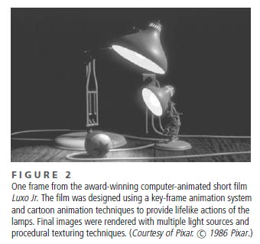

Slide 18
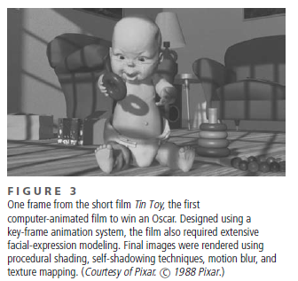

Slide 19
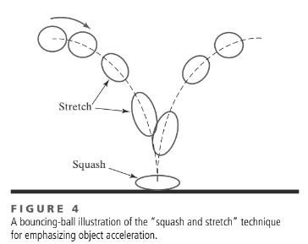
Traditional Animation Techniques
One of the most important techniques for simulating acceleration effects, particularly for nonrigid objects, is squash and stretch.
Figure 4 shows how this technique is used to emphasize the acceleration and deceleration of a bouncing ball.
As the ball accelerates, it begins to stretch. When the ball hits the floor and stops, it is first compressed (squashed) and then stretched again as it accelerates and bounces upwards.

Slide 20
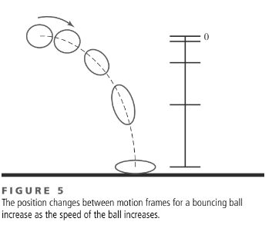
Traditional Animation Techniques
Another technique used by film animators is timing, which refers to the spacing between motion frames.
A slower moving object is represented with more closely spaced frames, and a faster moving object is displayed with fewer frames over the path of the motion.
This effect is illustrated in Figure 5, where the position changes between frames increase as a bouncing ball moves faster.

Slide 21
Traditional Animation Techniques
Object movements can also be emphasized by creating preliminary actions that indicate an anticipation of a coming motion. For example, a cartoon character might lean forward and rotate its body before starting to run; or a character might perform a “windup” before throwing a ball.
Similarly, follow-through actions can be used to emphasize a previous motion. After throwing a ball, a character can continue the arm swing back to its body; or a hat can fly off a character that is stopped abruptly.
An action also can be emphasized with staging, which refers to any method for focusing on an important part of a scene, such as a character hiding something.

Slide 22
4 General Computer-Animation Functions
Many software packages have been developed either for general animation design or for performing specialized animation tasks. Typical animation functions include managing
object motions,
generating views of objects,
producing camera motions, and
the generation of in-between frames.
Some animation packages, such as Wavefront for example, provide special functions for both the overall animation design and the processing of individual objects.

Slide 23
4 General Computer-Animation Functions
Others are special-purpose packages for particular features of an animation, such as a system for generating in-between frames or a system for figure animation.
A set of routines is often provided in a general animation package for storing and managing the object database. Object shapes and associated parameters are stored and updated in the database. Other object functions include those for generating the object motion and those for rendering the object surfaces.
Movements can be generated according to specified constraints using two- dimensional or three-dimensional transformations.

Slide 24
4 General Computer-Animation Functions
Standard functions can then be applied to identify visible surfaces and apply the rendering algorithms.
Another typical function set simulates camera movements.
Standard camera motions are
zooming,
panning, and
tilting.
Finally, given the specification for the key frames, the in-betweens can be generated automatically.

Slide 25
Computer-Animation Languages
We can develop routines to design and control animation sequences within a general-purpose programming language, such as C, C++, Lisp, or Fortran, but several specialized animation languages have been developed.
These languages typically include a graphics editor, a key-frame generator, an in-between generator, and standard graphics routines.

Slide 26
Computer-Animation Languages
The graphics editor allows an animator to design and modify object shapes, using spline surfaces, constructive solid geometry methods, or other representation schemes.
An important task in an animation specification is scene description.
This includes the positioning of objects and light sources, defining the photometric parameters (light-source intensities and surface illumination properties), and setting the camera parameters (position, orientation, and lens characteristics).

Slide 27
Computer-Animation Languages
Key-frame systems were originally designed as a separate set of animation routines for generating the in-betweens from the user-specified key frames.
Now, these routines are often a component in a more general animation package. In the simplest case, each object in a scene is defined as a set of rigid bodies connected at the joints and with a limited number of degrees of freedom.

Slide 28
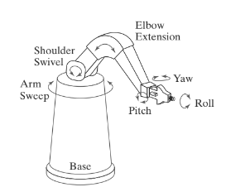
Computer-Animation Languages
As an example, the single-armed robot in Figure 6 has 6 degrees of freedom, which are referred
to as arm sweep, shoulder swivel, elbow extension, pitch, yaw, and roll.
FIGURE 6
Degrees of freedom for a stationary, single-armed robot.

Slide 29
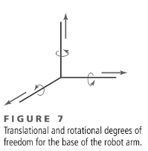
Computer-Animation Languages
We can extend the number of degrees of freedom for this robot arm to 9 by allowing three-dimensional translations for the base (Figure 7). If we also allow base rotations, the robot arm can have a total of 12 degrees of freedom. The human body, in comparison, has more than 200 degrees of freedom.

Slide 30
Computer-Animation Languages
Parameterized systems allow object motion characteristics to be specified as part of the object definitions. The adjustable parameters control such object characteristics as degrees of freedom, motion limitations, and allowable shape changes.
Scripting systems allow object specifications and animation sequences to be defined with a user-input script. From the script, a library of various objects and motions can be constructed.

Slide 31
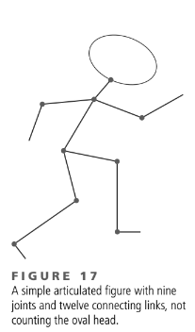
Character Animation
Articulated Figure Animation A basic technique for animating people, animals, insects, and other critters is to model them as articulated figures, which are hierarchical structures composed of a set of rigid links that are connected at rotary joints (Figure 17).
In less formal terms, this just means that we model animate objects as moving stick figures, or simplified skeletons, that can later be wrapped with surfaces representing skin, hair, fur, feathers, clothes, or other outer coverings.

Slide 32
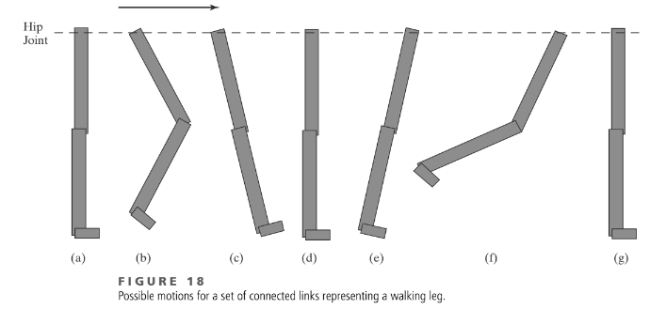
Character Animation
A series of walking leg motions, for instance, might be defined as in Figure 18. The hip joint is translated forward along a horizontal line, while the connecting links perform a series of movements about the hip, knee, and angle joints. Starting with a straight leg [Figure 18(a)], the first motion is a knee bend as the hip moves forward [Figure 18(b)]. Then the leg swings forward, returns to the vertical position, and swings back, as shown in Figures 18(c), (d), and (e).

Slide 33
Motion Capture
An alternative to determining the motion of a character computationally is to digitally record the movement of a live actor and to base the movement of an animated character on that information. This technique, known as motion capture or mocap, can be used when the movement of the character is predetermined (as in a scripted scene). The animated character will perform the same series of movements as the live actor.

